Slide 1
Employee Indebtedness to the City of Chicago
Data Curation Project for CS520 (Data Integration, Warehousing, and Provenance) - Fall 2023
Utsav Pathak, Dhruv Dasadia, Dharmik Dharmesh Patel
(Group 14)

Slide 2
Abstract
The employee indebtedness to the city of Chicago dataset has information on the public employees, categorized by the department, who owe money to the city as well as categorized departments and percentage of net debt owed. In this project we take this data, clean and pre-process it to level the fields and debt mechanism and try to build an ETL process over it with respect to the federal debt data and try to understand the debt mechanism and atrocities in the data related to debt calculation.

Slide 3
Introduction
The dataset that we consider for this project is from the mid of October 2011 to 09th November 2023 so that our cleaning mechanism does not need updating and we can cross validate if the mechanism is sufficient for the data that is updated later.
This is a non-federal dataset which also means in case of debt, the dataset has higher number of issues with the standardization and in cases where the debt is soluble and paid to the federal authority directly or passes a clearance under from the federal net debt authority might have a higher chance of not getting updated, which therefore results in a mismatch between the data obtained from the Chicago dataset website as well as the federal debt disclosure.

Slide 4


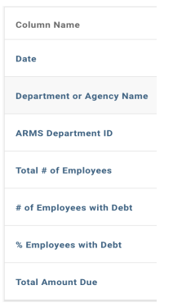









Metadata Overview
Since the dataset is updated weekly, the number of rows increases, as of 09th November 2023, the dataset has 20593 rows.
The dataset has several fields with NULL or No Values, these are mostly the ARMS_Department_ID, Total Number of Employees (Total_of_Employees), Number of Employees with Debt (_of_Employees_with_Debt) and Percentage of Employees with Debt (_Employees_with_Debt).

Slide 5
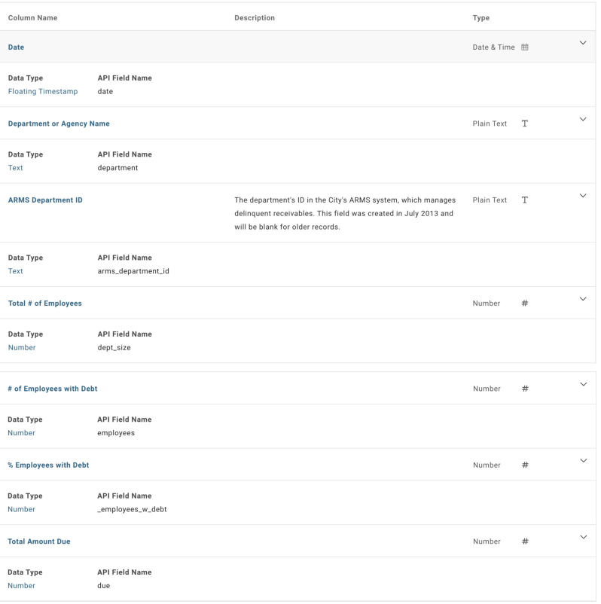
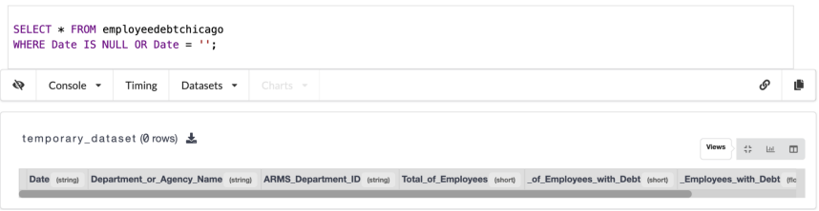
Metadata Overview (Contd.)
The good thing is that the dates in the dataset are consistent, and all the date fields are filled in the same order and none of them are empty or NULL.

Slide 6
Discrepancies in the Data
Inconsistencies in data reporting: The dataset is updated weekly, but the data is not always reported consistently. For example, the total amount of debt owed by employees may vary from one week to the next, even if the number of employees who are indebted to the city remains the same.
Lack of transparency: The dataset does not provide any information about the reasons why employees are indebted to the city.
The dataset also contains some specific inconsistencies. For example, the dataset shows that the Chicago Police Department has the highest number of employees who are indebted to the city, but the total amount of debt owed by CPD employees is lower than the total amount of debt owed by employees of other departments.

Slide 7
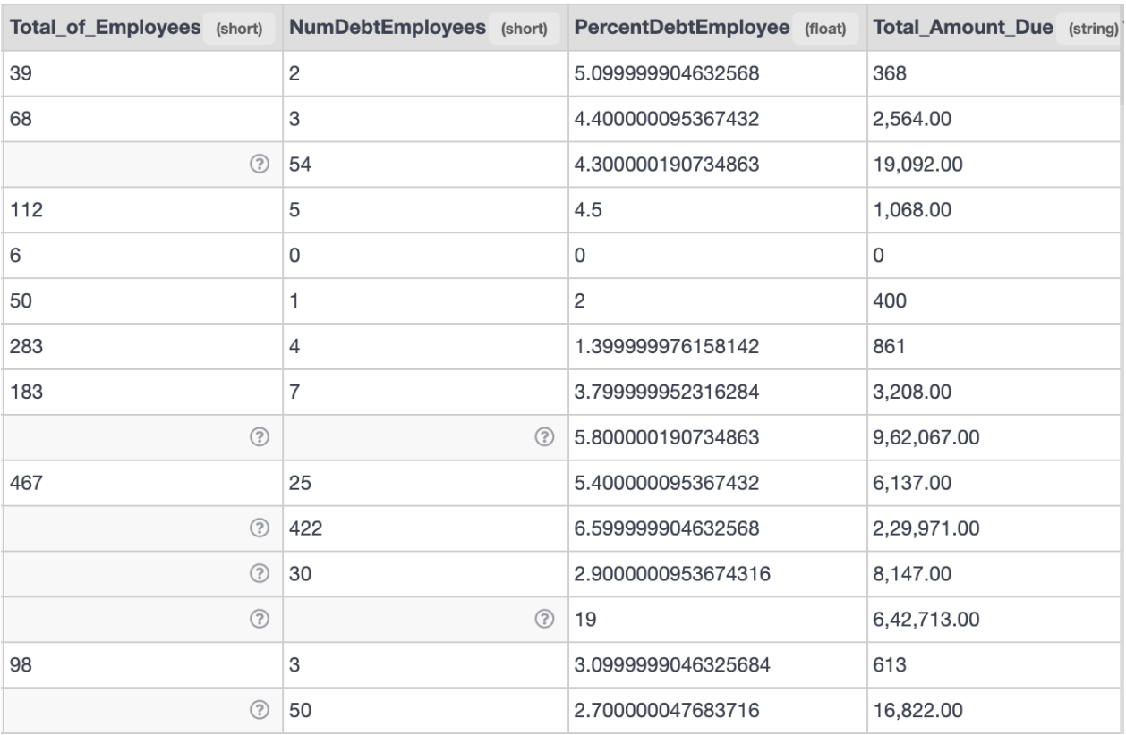
Discrepancies in Data (Contd.)
Missing values are in the following combinations-:
Total Number of Employees
Total Number of Employees and Number of Employees with Debt
All three (including Percentage of Employees with debt)

Slide 8
Repopulating Values
Values are repopulated in cases where we have Percentage of Employees with Debt and Total Number of Employees, we can find the number of employees with debt by just taking a percentage.
The same thing is done for total number of employees in cases where we have percentage of employees with debt and number of employees with debt.
X % of Total Number of Employees = Number of Employees with Debt
X is the Percentage of Employees with Debt
We update this using the update table mechanism.

Slide 9
Cleaning and Reconfiguration of ARMS IDs
Currently, we discover that many of the columns in Total_of_Employees, PercentDebtEmployee, and NumDebtEmployee are NULL or have no values at all. We attempt to eliminate them by identifying the columns that do not include the number of workers who are in debt or their percentage of debt. We apply the formula to populate values in the total number of workers in the two rows where we have total but not in the other one. The dataset reveals that while the number of CPD workers with outstanding municipal debt is more than that of employees from other departments combined, the total amount of debt owed by CPD employees is still less than that of the other departments combined.

Slide 10
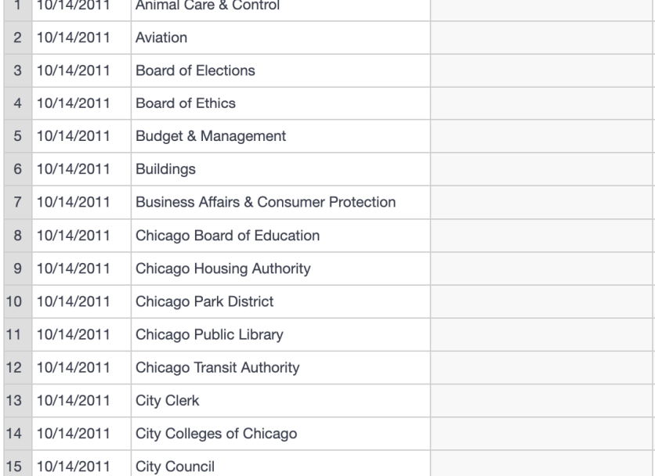
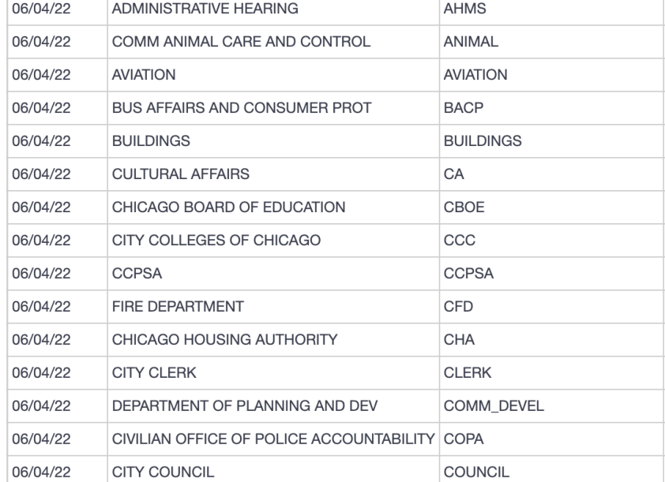
Removal Standardization for ARMS IDS
We removed the rows where ARMS IDs and total employees or number of employees with debt and percentage were not present and also could not be calculated with the formula above or even with a median lens or the aggregation function.

Slide 11
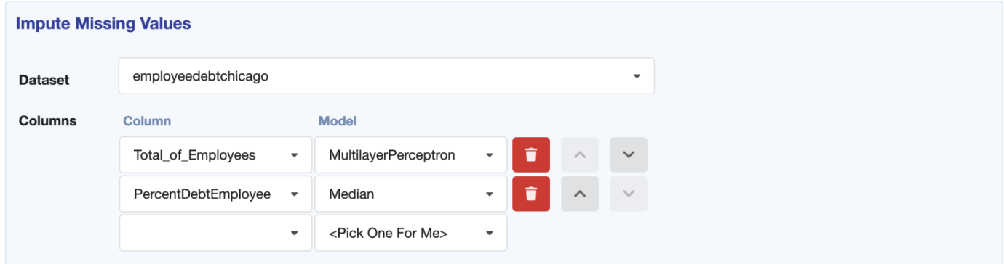
Experimenting with Perceptron to Impute values
This is not a good idea for the dataset as it dosen't work well for most.

Slide 12
ETL Mechanism on Dataset
One of the most important steps in data management is extracting, converting, and loading (ETL) data into the desired database on the VizierDB once it has been retrieved from a variety of sources. We examine the ETL procedure in this instance to show how to glean valuable insights from unprocessed data.
We merge with the federal debt dataset for Chicago to validate net debt and find that changes are not made in this data even if debt is paid (ref. federal data) or is waived off.

Slide 13
Provenance
Provenance (in case of time and date) is really good with this data, although the major issue arises when we try to find origin of the information, calculation metrics and the quantity, this is ensured with the anomalies in debt calculation of CPD. The metadata is clear and so are the dependencies that helped us in populating the columns of the data such as total number of employees and number of employees with debt, this aided as we prevented almost half of the NULL Fields from being dropped out of the table. We have no idea about the interactions and update on the data, that is if debt is removed or not, from what we obtain, is that new debt is added but old debt is not removed or there is no way to trace of it is paid or vacated by federal reserves, which is a major issue in understanding if the net debt obtained is true or not.

Slide 14
Limitations of the Analysis
Our analysis limits to handling and filling the employees count and creating an ETL with the federal debt sheet.
We also tried to come up with processes to help calculate and mark the debt better and focus on specific departments such as the CPD and also try to find the missing ARMS IDs and try and check if they map with any existing ARMS IDs or are sub departments of a larger department.

Slide 15
Conclusion
We realized that a lot less work has been done on the debt data, at least for the part which is publicly available and there is no background on how the data is collected or kept and maintained, which causes a lot of issues and anomalies that are expressed earlier in the report. This issue caused the larger part of this project to be spent on understanding and cleaning the data, which we only got to know as we started working on the data further and had not expected the anomalies to be so large at the beginning of the project.

Slide 16
Future Scope of Work
We need a better understanding of the dataset and how the debt is calculated and reported, which will further help in understanding the data and help create a proper analytics dashboard. The dataset is updated weekly and some new issues may arise in the data, so we would need to create a mechanism to understand these new changes and create new filters and a fault tolerant mechanism for the analytical dashboard (if created) to be responsive.

Slide 17
THANK YOU
We are open to Questions Now!!

